Slide 1
St. Luke’s UMC
Congregational Survey Results
Spring 2020

Slide 2
Spring 2020: Congregational Listening Approach
Congregational Pulse
How are we doing?
Full Congregation
Returning to Church Intentions
745 RESPONSES
1298 RESPONSES

Slide 3
Themes Across Surveys
Congregational Pulse
Returning to Church
Member sentiment for the church has remained stable through the healthcare crisis, and the majority of those surveyed say their involvement with the church has remained consistent.
Ratings for the overall experience and commitment to St. Luke’s are at the highest point in several years.
St. Luke’s is reaching members through the various virtual channels, and 96% of those responding to the survey have participated in the online service.
15% will continue to attend online more frequently once the church opens; others will only use the online option if needed.
The majority of results suggest that members will follow state guidelines, returning to church when stay-at-home orders are lifted or when other public gatherings have resumed.
Members will expect restrictions when returning, such as social distancing and not shaking hands.
Similar to results found in the congregational pulse and member panel, members are heavily utilizing email messages such as Rev-elations and Mobile messages.

Slide 4
Survey Response Representation: 745 Total Responses
Length of Time with St. Luke’s
Age
This wave does represent slightly more tenured members and less new members than was gathered in the Fall of 2019
(+14)

Slide 5
Overall Member Relationship Trend
“I have been so impressed with all of the programs, services, and communications that St. Luke's has been offering during this abnormal time. Thanks to all that have made this possible.”

Slide 6
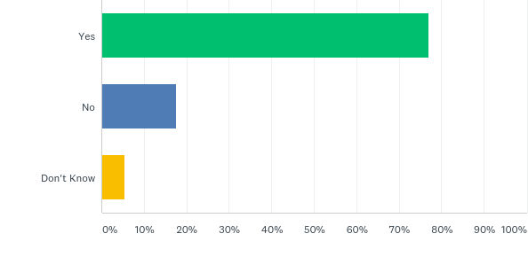
Have you received a phone call or email from a staff member or volunteer during this period of shelter-in-place?
77%
18%
5%

Slide 7
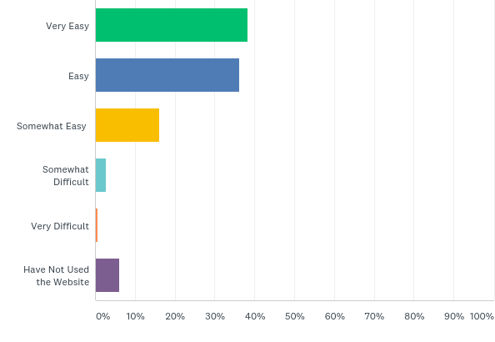
If you have visited the church website during the shelter-in-place, how easy was it for you to find the information you needed?
38%
36%
16%
3%
1%
Only 6% of those surveyed have not used the website in recent months.
6%

Slide 8
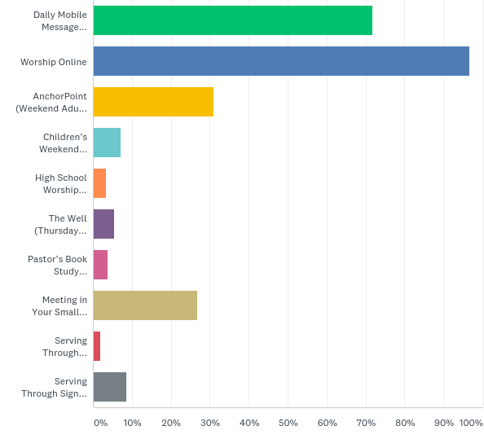
Please select which of the following items you or your family members have participated in.
72%
96%
31%
“Thanks for the mobile moments and Anchor point as additional ways to stay connected to the church and be encouraged. Thanks to everyone who works so hard to make all these opportunities available.”
7%
3%
5%
4%
27%
2%
9%

Slide 9
How much do you agree or disagree with each statement?
“Worshiping online is not ideal, but the staff has done an outstanding job with all the services to make us feel connected during worship. We will worship on line as long as necessary, but can't wait until we can gather to praise God together!”

Slide 10
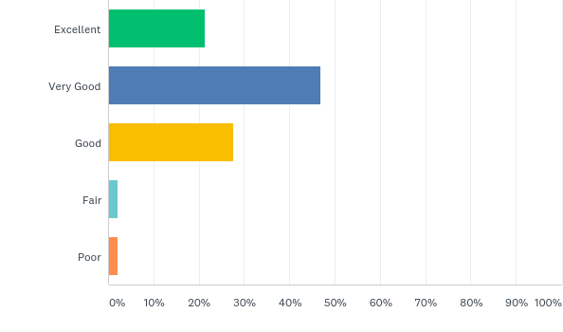
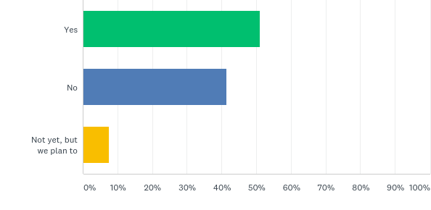
Sunday School (12% of those surveyed have children who attend Sunday School)
Have your children been using e-learning and online Sunday School options?
How would you rate the online and virtual materials and classes that you have received?
21%
51%
47%
28%
42%
2%
7%
2%

Slide 11
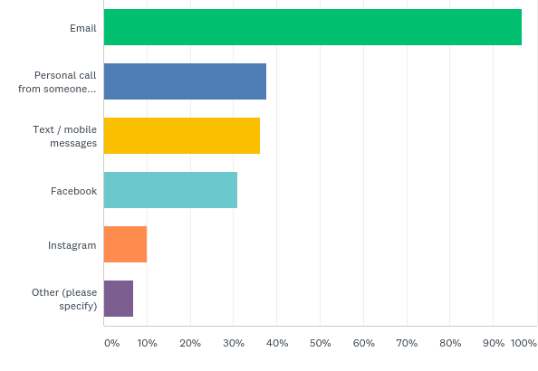
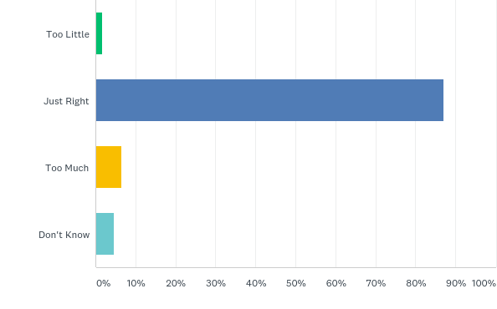
Communications
Which of the following communication platforms have you utilized over the past month?
How would you rate the frequency of communications from St. Luke’s across channels?
97%
2%
38%
36%
87%
31%
7%
10%
7%
5%

